Slide 1
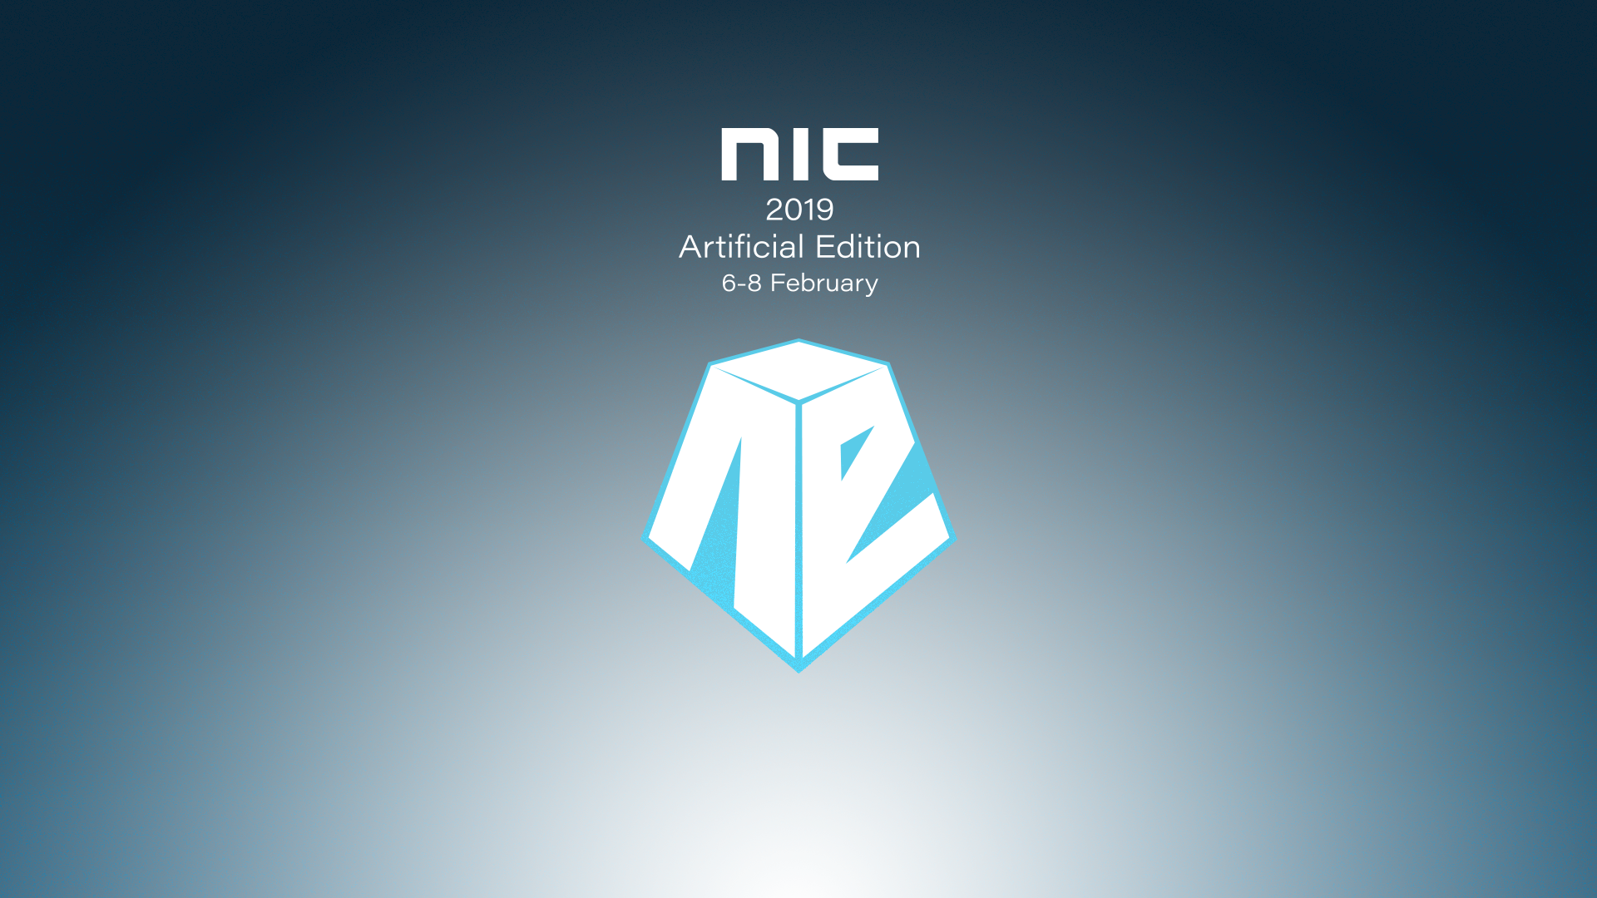

Slide 2

Simon Woods
Solution Engineer at 1E
simon.woods@1e.com Stand 12

Slide 3

Signify and 1E a timeline
Phillips SCCM and 1E Self Service
Phillips divest Lighting Business
New Business to go Purely InTune
Transformation Project to Win10 SCCM and 1E entirely InTune by end of year
Signify is born InTune and 1E
1E Shopping
1E Nomad
1E Nomad
1E Tachyon

Slide 4
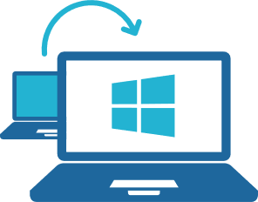
Win 10 Transformation Use Cases
Checking Patch Compliance for Wanna Cry
One Drive Migration
Identify Users not using One Drive
Re-point One Drive Clients to correct Servers
Report One Drive Sync Status
Establish Bit Locker Status of every Drive
Deployment of Non-MSI based Applications
Removal of Non-MSI bases Applicaitons
Modify Registry keys for Zscaler VPN

Slide 5

Since the Transformation
Name change​ - To Signify
Roll out of 1709 Feature Update
Patching​
Dealing with attacks eg admin password in Intel CPU​
Infrastructure google eg Game of Thrones​
Changing settings eg user logon screen​
Security​
Microsoft update control​
Software removal​
Changing of Periodic license keys
More Info https://www.1e.com/resources/case-study/signify-1e-what-every-cio-needs-to-know-about-tachyon/

Slide 6

DEMO TIME

Slide 7

Re-Cap: What the **** just happened?
Search for Installed Software
Active Network connections
Quarantine Device with Notification
Kill Processes
Find Files
Remote delete Files
Look in WMI
Delete WMI entries
Look in Registry
Delete Registry entries
Set Firewall rules
Release Device from Quarantine
Start the SCCM Services

Slide 8
Questions?

